Slide 1


C Programing
Prof. John Y. Chiang
Dept. of Computer Science & Engineering
National Sun Yat-sen University
chiang@cse.nsysu.edu.tw
http://image.cse.nsysu.edu.tw

Slide 2
Contents
1 C Overview
2 Selection and Decision
3 Repetition and Loops
4 Function
5 Arrays
6 Pointers I
7 Pointers II
8 Structure
9 Link list
10 Class and object

Slide 3

Lecture 2
Selection and Decision

Slide 4

Introduction
Control Structure:
    A single logical unit of statements with one entry and one exit point, used to specify sequential control. For example:
        sequence
        selection or decision
        repetition

Slide 5
Introduction
Compound Statement:
    A group of statements bracketed by { } and executed sequentially.
        Ex.
        int main (void)
        { . . .
        }

Slide 6
Introduction
Equality and relational operators:

Slide 7
Introduction
    Ex.
    const int FALSE = 0;
    (4 <= 3) evaluates to FALSE
    (17 != 17) evaluates to FALSE
    (6 == 6) evaluates to !FALSE (true)
    (15 > 10) !FALSE (true)
Note: If an expression evaluates to 0, the expression is false; otherwise the expression is true.

Slide 8
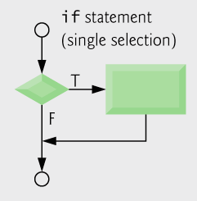
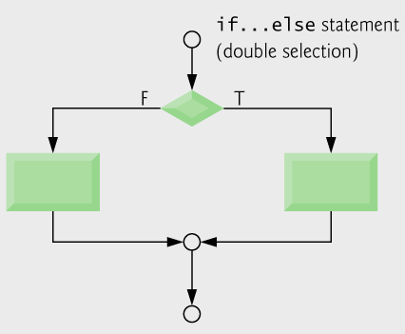
Decision
Syntax of simple if
    if(logical expression)
    executable statement
Syntax if-else:
    if(logical expression)
    executable statement1
    else
    executable statement2

Slide 9
Decision
Syntax else-if:
    if(logical expression1)
    executable statement1
    else if(logical expression2)
    executable statement2
    else if(logical expression3)
    executable statement3
    else
    executable statement4

Slide 10
Decision
Selection Examples:
    The following three if statements are functionally equivalent.
        if(x != 0) printf("true\n");
        if( !(x == 0) ) printf("true\n");
        if(x) printf("true\n");

Slide 11
Decision
    Are the following two if statements functionally equivalent?
        if((n / 1000) > 0)
        printf("n has 4 or more digits\n");
        if(n / 1000)
        printf("n has 4 or more digits\n");
    The answer is YES if n is positive.
    If n is negative?
    Trace with values
    n = 999, n = 1000, n = -999 and n = -1000.

Slide 12
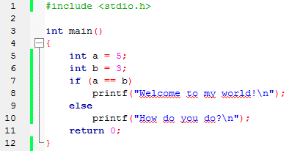
Decision
Ex.

Slide 13
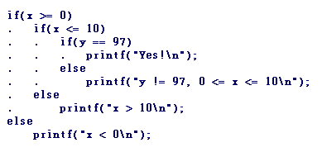
Decision
More Examples:
    Notice the spacing in the example below. The match between each if and else is clear. An else goes with the most recent active if.

Slide 14
Decision
    Ex.
        /* Display a grade-based message */
        if(grade == 'A') printf("Excellent\n");
        if(grade == 'B') printf("Good\n");
        if(grade == 'C') printf("Average\n");
        if(grade == 'D') printf("Barely\n");
        if(grade == 'F') printf("Welcome back\n");
    The spacing is attractive, but the code is poor for a couple of reasons. Why?

Slide 15
Decision
    Let's rewrite this code to make it more efficient and more robust.
        /* Print a grade-based message */
        if(grade == 'A') printf("Excellent\n");
        else if(grade == 'B') printf("Good\n");
        else if(grade == 'C') printf("Average\n");
        else if(grade == 'D') printf("Barely\n");
        else if(grade == 'F') printf("Welcome back\n");
        else printf("Input error. %c is an invalid grade.\n", grade);

Slide 16
Decision
C code:
    if( grade >= 60 )
    printf( "Passed\n");
    else
    printf( "Failed\n");
Ternary conditional operator (?:)
    Takes three arguments (condition? value if true: value if false)
    Our pseudocode could be written:
        printf( "%s\n", grade >= 60 ? "Passed" : "Failed" );
    Or it could have been written:
        grade >= 60 ? printf( “Passed\n” ) : printf( “Failed\n” );

Slide 17
Decision
    EX.
    /* Which is bigger */
    if(x >= y)
    bigger = x;
    else
    bigger = y;
    EX.
    bigger = x >= y ? x : y;

Slide 18
Decision
Compound Statement Examples:
    Nested if-else example:
        if(code == 0){ // code is zero
        scanf("%d", &x);
        flag = (x >= 100);
        if(flag) //code is zero AND x >= 100
        printf("3 or more digits\n");
        }
        else // code is not zero
        . . .

Slide 19
Decision
    The else clause can be a single statement or a compound statement. A different way would be the following code.
      if(!code) { //code is zero
      scanf("%d", &x);
      if(x >= 100) //code is zero AND x >= 100 printf("3 or more digits\n");
      } else // code is not zero
      . . .

Slide 20
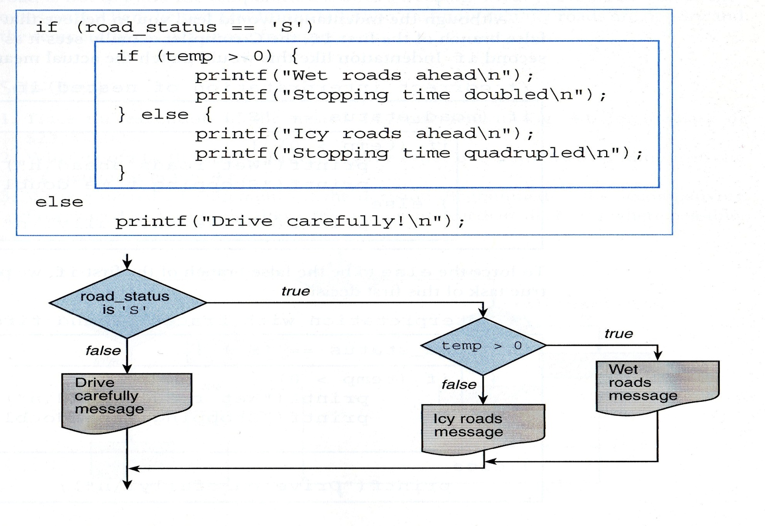
Decision
    Another nested if-else example:

Slide 21
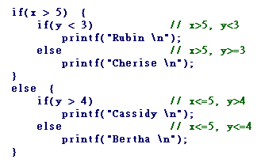
Decision

Slide 22
Decision
More Expressions:
    The following declarations and initializations:
          int x = 1, y = 2, z = 3;
          The expression x >= y evaluates to 0 (false).
          The expression x + y evaluates to 3 (true).
          The expression x = y evaluates to 2 (true).
          The expression x == y evaluates to 0 (false).
          The statement z = Is_odd(2); evaluates to 0 (false).
          The expression x <= y evaluates to non-zero (true).

Slide 23
Decision
    Recall: Expressions can be in printf() statements such as
    printf("%d\n", x>y);
    Is_odd(): Function Is_odd() determines if an integer is even or odd.
    EX.
    #include<stdio.h>
    #define FALSE 0
    int Is_odd(int);
    /* function prototype */
    . . .

Slide 24
Decision
      Ex.
          int Is_odd(int x) {/*function header*/
          if(x%2 == 0) return FALSE;
          /* input is an even number */
          else return !FALSE;
          /* input is an odd number */
          }
    In calling function:
        if(Is_odd(n)) printf("%d is odd.\n",n);
        if(!Is_odd(n)) printf("%d is even.\n",n);

Slide 25
Decision
      A better way to define the same function.
      int Is_odd2(int x) {
      return (x % 2) != 0;
      }
      The call Is_odd2(17) returns 17 % 2 or 1, which is true.
      The call Is_odd2(24) returns 24 % 2 or 0, which is false.

Slide 26
Decision
      Finally, let's examine the best way to define the same function.
      int Is_odd3(int x) {
      return x % 2;
      }
      The call Is_odd3(17) returns 17 % 2 or 1, which is true.
      The call Is_odd3(24) returns 24 % 2 or 0, which is false.

Slide 27
Decision
Function Calls:
    /* Store the returned value. */
    code = Is_odd3(value);
    /* Test the returned value.*/
    if(Is_odd3(number)) sum += number;
    /* Print the returned value. */
    printf("The returned value is %d.\n", Is_odd3(number));

Slide 28
Decision
    Caution: The code below doesn't use the returned value; often not good.
      Is_odd3(a);
      // Call Is_odd3( ), but don't store, test, or use the returned value

Slide 29
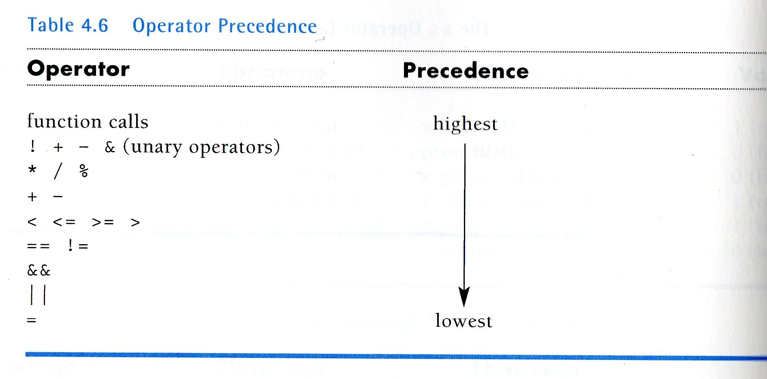
Decision
Operator Precedence:

Slide 30
Decision
Logical Operators:
    && and binary operator,
    requires two operands
    || or binary operator,
    requires two operands
    ! Not unary operator,
    requires one operand

Slide 31
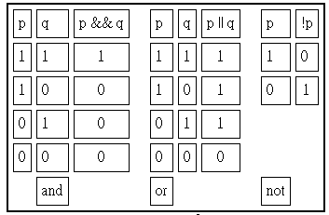
Decision
Given expressions p and q:
TRUTH TABLE FOR and, or, not

Slide 32

Decision
    Ex. If p is (x > y) and q is (y >= z), then p&&q can be written as:
    (x > y) && (y >= z)
    Therefore if the expression above is true and y is 10, then z must be <=10, and x must be >10.

Slide 33
Decision
    As a C statement:
    if(x > y && y >= z)
    printf("x is the largest\n");
    Always ask, "What values make the condition true (non-zero)?"

Slide 34
Decision
    With an expression of the form p&&q, C stops the evaluation if p is false.
    With an expression of the form p||q, C will executes the evaluation if p is true.
Logical Operators | p | q | output
&& | false | Not execute | false
&& | true | Execute | q
|| | false | Not execute | true
|| | true | Execute | q

Slide 35
Decision
    Ex.
    (a != b) || (b != c)
    If the expression is true, a, b, and c are not identical. Can a equal c?
    if(a != b || b != c)
    printf("a, b, and c are not identical. \n");

Slide 36
Decision
    Are the two statements below functionally equivalent? Trace with various values to see.
    if(a != b && b != c)
    printf("b is unique.\n");
    if(!(a == b) && !(b == c))
    printf("b is unique.\n");

Slide 37
Decision
    Ex.
    /* x is either less than 1 or greater than 100. */
    if(x <= 0 || x > 100)
    printf("x not in 1 . . . 100\n");
    /* x is between 1 and 100. */
    if(x > 0 && x <= 100)
    printf("Range of x is 1 ... 100\n");

Slide 38

Decision
    Now let's exchange logical operators.
    /* Test for erroneous values of x. */
    if(x <= 0 && x > 100)
    printf("Not possible!!\n");
    if(x > 0 || x <= 100)
    printf("Always true!\n");

Slide 39

Decision
    Ex.
    /* Is ch an uppercase alphabetic character? */
    if(ch >= 'A' && ch <= 'Z')
    <executable statement>
    /* Is ch any alphabetic character? */
    if((ch >= 'A' && ch <= 'Z') || (ch >= 'a' && ch <= 'z'))
    <executable statement>

Slide 40
Decision
    Ex. 1 Combine if statements by using a single if and logical operators.
    /* Nested if-else statements (braces not required) */
    if(grade > 80) {
    if(attendance > 90) {
    if(lab_scores > 95) {
    printf("\n Grade is A\n");
    }
    }
    }

Slide 41
Decision
    Ex. 1 Combine if statements by using a single if and logical operators.
    /* Rewrite using logical operators */
    if(grade > 80 && attendance > 90 && lab_scores > 95)
    printf("\n Grade is A"\n");

Slide 42
Decision
    Ex. 2 else goes with the most recent active if.
    /* What gets printed? */
    int x = 8, y = 4;
    if(y <= x)
    if(x > 8)
    x++;
    else
    y--;
    printf ("%d %d\n", x, y);

Slide 43
Decision
    Ex. 3 Braces change the matching order of if-else statements.
    /* What gets printed? */
    int x = 8, y = 4;
    if(y <= x){
    if(x > 8)
    x++;
    }
    else
    y--;
    printf ("%d %d\n", x, y);

Slide 44
Multiple Selection
switch:
    Useful when a variable or expression is tested for all the values it can assume and different actions are taken.
    syntax: (form)
    switch(controlling expression) {
    label set 1: statements set 1
    label set 2: statements set 2
    . . .
    label set n: statements set n
    default: statements set x
    }

Slide 45
Multiple Selection
    default is optional.
    The break statement is often used to terminate the switch( ) construct.
    break may be used to end any C control structure.
    switch( ) provides a clean, easy-to-read alternative to the compound if-else in many instances.

Slide 46
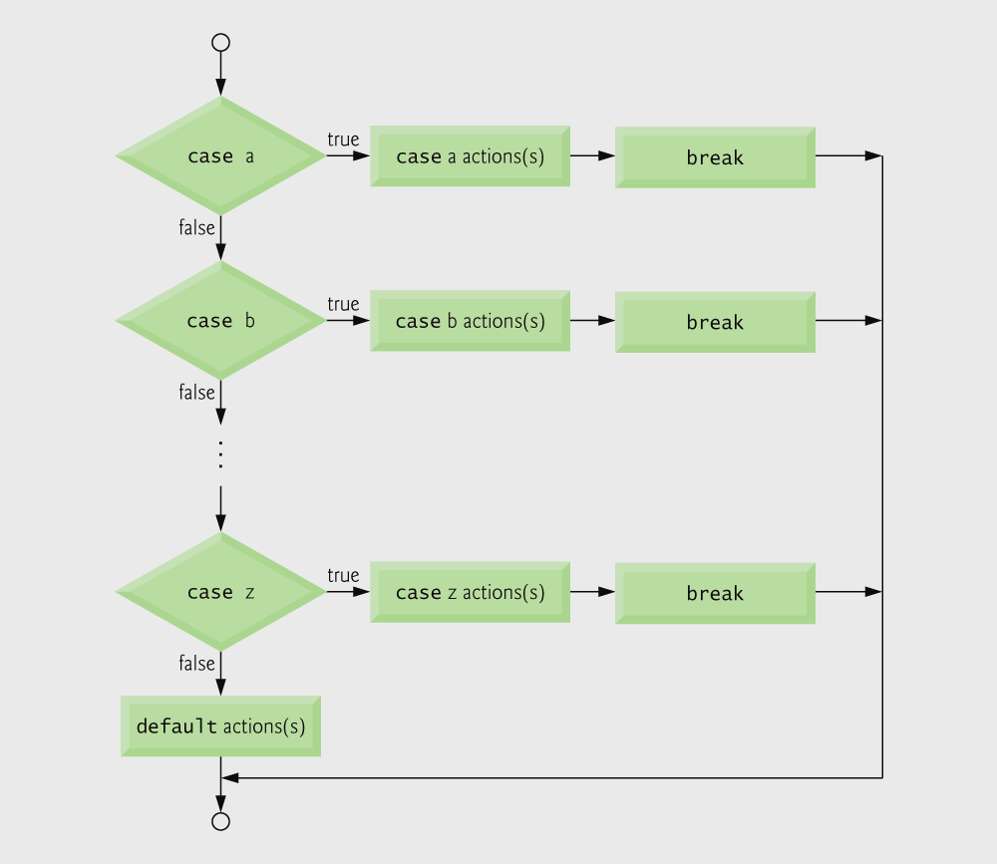
Multiple Selection

Slide 47
Multiple Selection

Slide 48
Multiple Selection
    Ex. 1
    scanf("%c",&grade);
    switch(grade) {
    case 'A': printf(...); break;
    case 'B': printf(...); break;
    case 'C': printf(...); break;
    case 'D': printf(...); break;
    case 'F': printf(...); break;
    default : printf(...);
    }

Slide 49
Multiple Selection
    Ex. 2
    scanf("%d", &x);
    switch(x) {
    case 25: x++;
    case -4: x--;
    break;
    case 62: x += 6;
    default: x--;
    }
    printf("%d", x);

Slide 50
Multiple Selection
    Ex. 2
Original value of x: | Value of x displayed:
25 | 25
-4 | -5
62 | 67
93 | 92
0 | -1

Slide 51
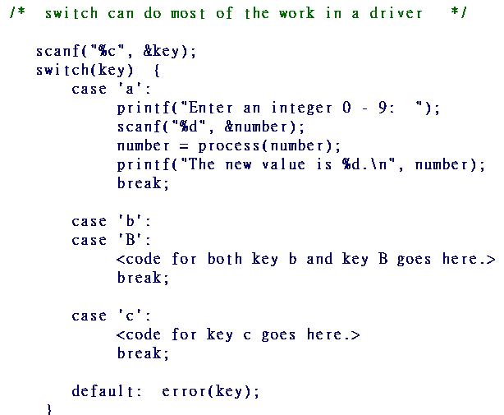
Multiple Selection
    Ex. 3

Slide 52
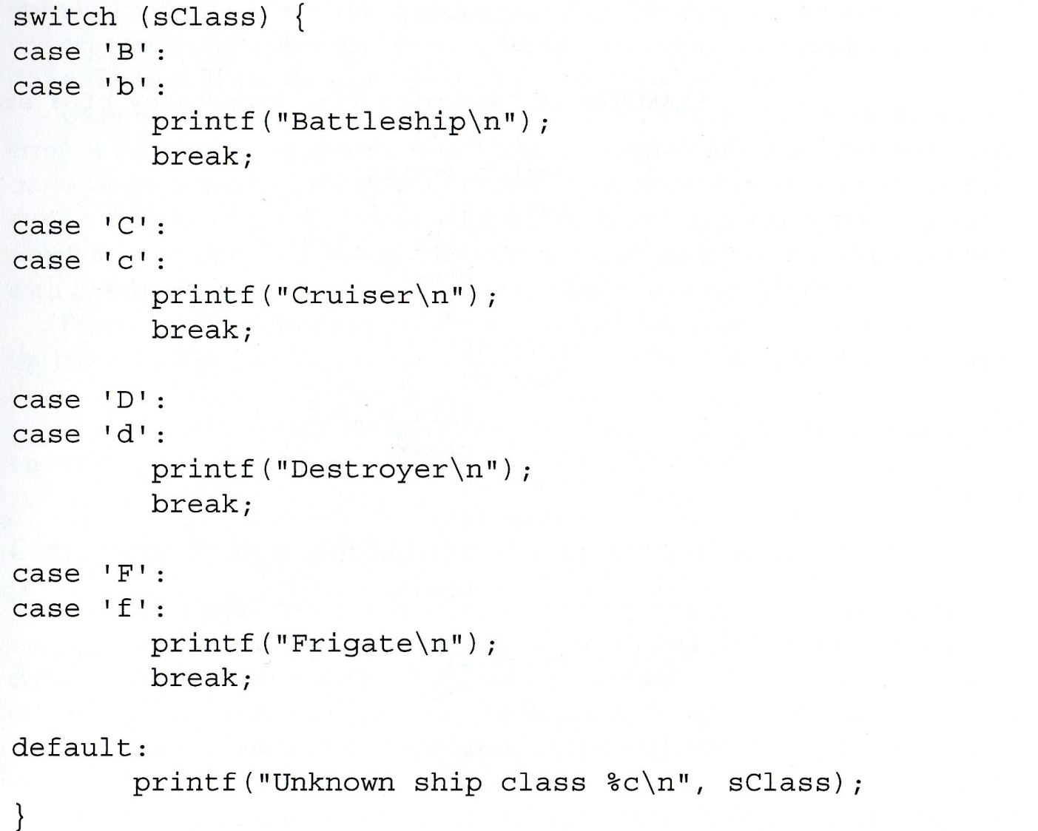
Multiple Selection
    Ex. 4

Slide 53
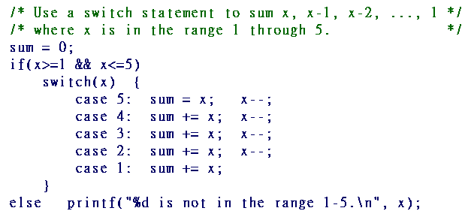
Multiple Selection
    Ex. 5

Slide 54
Multiple Selection
Notes:
    Controlling expression must produce an integer, such as:
        an integer
        a character (they are stored as integers)
        an integer expression, x==0 (for example)

Slide 55
Multiple Selection
The control structure switch( ) looks for a match between the controlling expression and a case value.
Once found, all remaining statements are executed with no further testing of case labels.
A break statement will transfer execution to the statement following the break control structure.

